Slide 1


Jawaharlal Nehru New College of Engineering
Department of Computer Science and Engineering
Project Presentation
ON
“Car Parking Slot Detection Using YOLO Algorithm”
DEEPTHI B A 4JN20CS026
DHANYATHA B 4JN20CS027
TANMAYEE SHARVANI 4JN20CS111
VARSHITHA H G 4JN20CS116
Under the guidance of
Mr.Mohan H G _{B.E., M.Tech.}
Assistant Professor, Dept. of CS&E
Coordinators:
Dr. Poornima K M _{B.E., M.Tech., Ph.D.} Mr.Hiriyanna G S_{. B.E., M.Tech.}
Asst. Professor, Dept. of CS&E Professor, Dept. of CS&E
Mrs.Pushpa R N _{B.E., M.Tech.} Dr.Ganavi M _{B.E., M.Tech., Ph.D}
Asst. Professor, Dept. of CS&E Asst. Professor, Dept. of CS&E

Slide 2
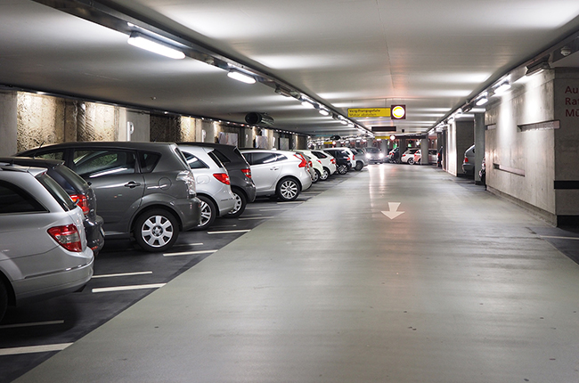
Content
Abstract
Introduction
Literature Survey
Problem Statement
Objectives
System Architecture
Results
Conclusion
References

Slide 3
ABSTRACT
Finding free slots in the parking area has become a major problem that the modern society is facing nowadays, which also leads to traffic overcrowding at the parking area. As the number of vehicles are increasing at a quick rate find parking slots has become difficult. In traditional parking system, a person has to find vacant slot or a gate keeper needs to inform about the available parking slot at parking area. To address this issue, a system is designed, where the user will be able to know the number of vacant slots in a particular parking area along with total number of slots at the entrance of the parking area. Today's most popular object detection model YOLO, is trained to achieve desired results with good precision scores at real-time speed. The model will be getting all the parking slots that are present in the parking area, to which marking boxes are drawn around for training. Real time processing is performed on the obtained data by the model to find whether the slot is vacant or occupied. Thus, it gives the information of available vacant slots to park the car at parking area.

Slide 4
INTRODUCTION
Object Detection
Object detection is a computer technology that deals with finding instances of semantic items of a specific class (such as individuals, buildings, or cars) in digital photos and videos. It is related to computer vision and image processing.
Computer vision
Computer vision is a field that explores how computers interpret and analyze visual information like images or videos. It seeks to replicate human visual abilities through techniques that capture, process, and understand digital images, extracting meaningful data for various applications, such as making decisions or recognizing patterns.
YOLO
YOLO (You Only Look Once) is an object detection algorithm that operates by dividing an image into a grid and predicts bounding boxes and class probabilities for objects within each grid cell. Unlike traditional methods that classify objects and then perform localization, YOLO does both tasks simultaneously in a single pass through the neural network. This approach makes YOLO extremely fast and capable of real-time object detection in images and videos. The YOLO series includes various versions such as YOLOv1, YOLOv2, YOLOv3, YOLOv4, YOLOv5, YOLOv6, YOLOv7 and YOLOv8.

Slide 5
LITERATURE SURVEY

Slide 6
SL. NO | TTITLE | AUTHOR | PUB YEAR | METHODOLOGY | ADVANTAGES | LIMITATIONS
1 | T-YOLO: Tiny vehicle Detection Based on YOLO and multi scale Convolutional neural networks | DANIEL PADILLA, HATEM A. RASHWAN et.,at. | 2020 | Dataset Description: Utilized the PKLot1 dataset for the research. Dataset Split: 80% of dataset for training and 20% of dataset for testing Baseline Model: The baseline model used in the study is YOLO v5. Data Augmentation Techniques: Applied mosaic/mixup to enhance diversity in the dataset. Utilized letterbox technique for resizing aspect ratio. | improved performance in vehicle detection provides high precision value | The adapted variation yields a decrease in speed

Slide 7
SL.NO | TITLE | AUTHOR | PUB YEAR | METHODOLOGY | ADVANTAGES | LIMITATIONS
2 | Car Detection Based Algorithm for Automatic Parking Space Detection | Raj Patel and Praveen Meduri | 2020 | Car Detection Model: Used CARPK dataset MAP(Mean Average Precision)was used to quantify the model performance. YOLOv4 model trained on MS COCO is tested on CARPK as a baseline Car Tracking: CNRPark+EXT [14] dataset was used to evaluate the tracking algorithm. IoU(Intersection of Union)ratio is used to identify car state | Increased Efficiency Real-time Updates Enhanced User Experience | Not completely automatic need human interaction Complex Environments Variable Vehicle Shapes and Sizes

Slide 8
SL.NO | TITLE | AUTHOR | PUB YEAR | METHODOLOGY | ADVANTAGES | LIMITATIONS
3 | Automated Vehicle Parking slot Detection system using deep learning | BANDI SAIRAM and ADITI AGRAWAL | 2020 | Initial Setup: Manually segment the parking slots based on live video streams from surveillance cameras. Assign an ID to each parking slot and geo-tag and map each slot alongside its ID. Live Video Stream Processing: Mask R-CNN model is used to detect vacant slots. Parking Slot Detection: Detect marking points and the type of parking slot. Use sensors to find free space between two vehicles | Fuel Savings Urban Planning Benefits Improved Efficiency | Difficulty in maintain sensor method is not completely automatic as it requires a car to be manually parked in the slot to start working.

Slide 9
SL.NO | TITLE | AUTHOR | PUB YEAR | METHODOLOGY | ADVANTAGES | LIMITATIONS
4 | Method for judging parking status based on yolov2 target detection algorithm | Hanbo Zhoua and Wei Xiangc | 2022 | Utilization of Public Parking Space Resources: Utilize public parking space resources on the roadside. Data Augmentation: To get accuracy of dataset flipping, zooming of the dataset is done. Machine Vision-Based Approach: The method proposes the use of a machine vision-based approach for distinguishing parking spaces. | Real-time Parking Information: Convenience and Efficiency Environmental | Accessibiliy , equity and security.

Slide 10
SL.NO | TITLE | AUTHOR | PUB YEAR | METHODOLOGY | ADVANTAGES | LIMITATIONS
5 | A Review: Object Detection Models. | AAKASH K. SHETTY, ISHANI SAHA et.,at. | 2021 | Data Augmentation: increase image variability and robustness Training Optimization: achieve greater precision without increasing the cost of inference. Anchor Boxes: Use of anchor boxes for multi-class identification Dimension Clustering: Achievement of dimension clustering using k-means clustering for constructing bounding boxes. | High-Resolution Classifier Improved Efficiency | Cannot be used for real-time Training, it requires lot of time as multiple stages are involved

Slide 11
SL.NO | TITLE | AUTHOR | PUB YEAR | METHODOLOGY | ADVANTAGES | LIMITATIONS
6 | Vehicle and Parking Space Detection Based on Improved YOLO Network Model | Xiangwu Ding , Ruidi Yang | 2020 | YOLO V3 Network Structure: YOLO V3 uses Darknet53 as its base network structure Data Sets: Three datasets are used: PASCAL VOC, COCO, and PKLot. The experiment focuses on the "car," "bus," and "truck" categories. Clustering Analysis of Anchor Boxes: The K-means clustering algorithm is used to cluster and classify car parking spaces in the dataset. | High Accuracy Real-time Processing | Complexity in Varied Environments Dependency on Quality and Quantity of Training Data

Slide 12
PROBLEM STATEMENT
As the population grows, there is an increase in the private vehicles which caused many issues to the people at the crowded areas such as shopping malls, restaurants and universities parking lots. This results in time waste for the drivers in search for the empty parking space which includes atmospheric pollution and frustration of the drivers. Developing a project that uses a camera to record real-time data and feed it to a system to discover vacant car parking slots in a parking area. Car parking slot detection using YOLO algorithm which calculates the number of vacant parking slots in a parking area based on the system's confidence level.

Slide 13
OBJECTIVES
To design a model that can efficiently detect the Empty and Occupied status of the parking space in an image and a video by making use of YOLO object detection.
To import an image from a webcam and performing the operations in the system.
To identify moving objects with high accuracy.
To provide information about vacant parking space in real time with efficient manner.
To avoid traffic congestion in parking space.

Slide 14
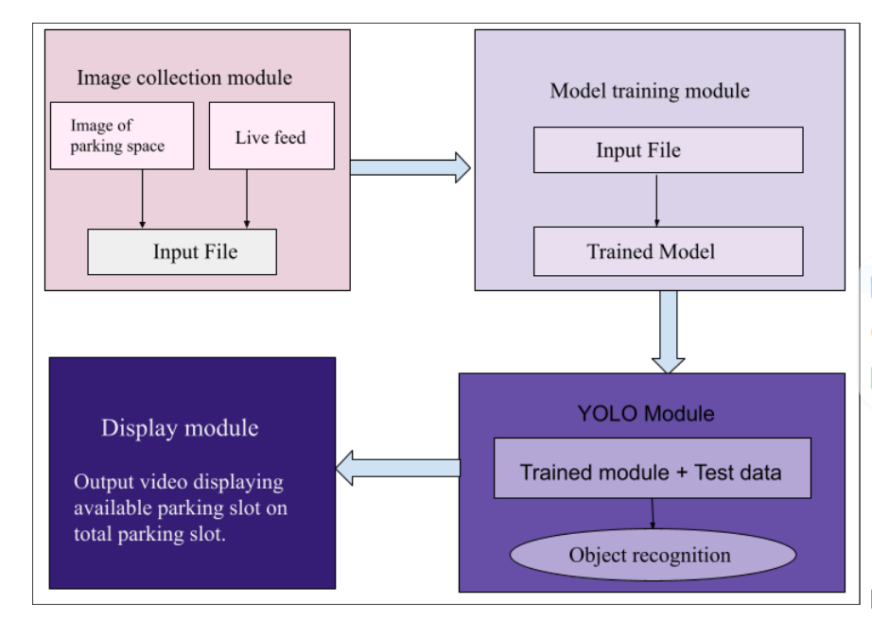
SYSTEM ARCHITECTURE
Fig 1: System Architecture

Slide 15
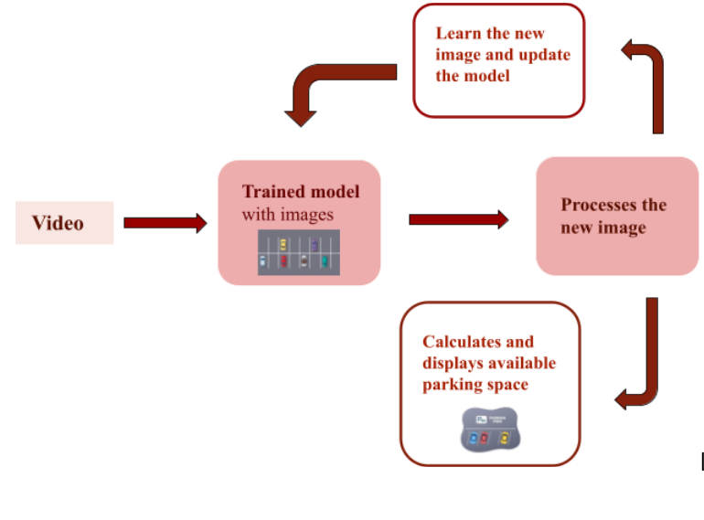
Fig 2: System overview

Slide 16
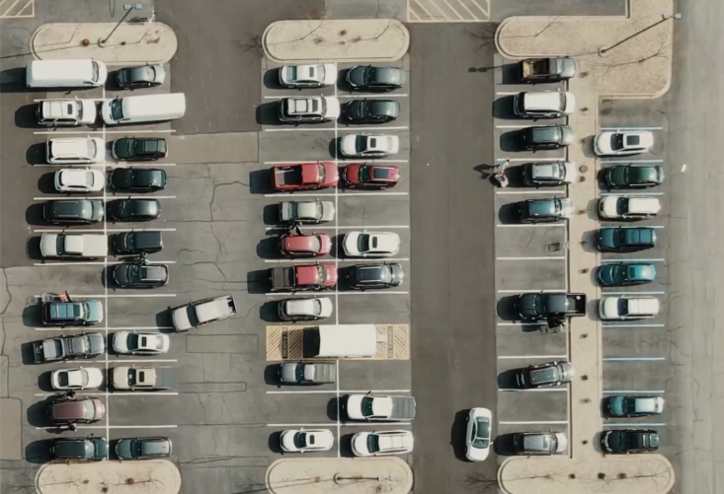
RESULTS
Fig 4:Parking area image

Slide 17
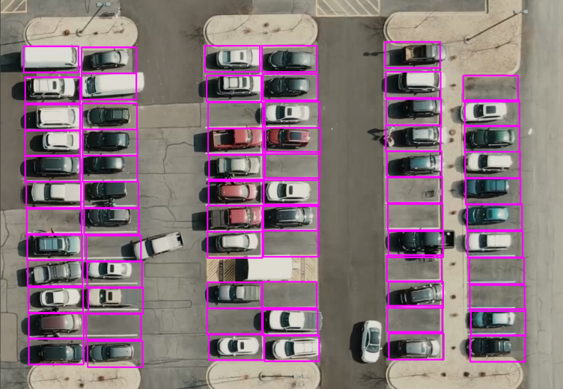
Fig 5: Parking area image with marked slots

Slide 18
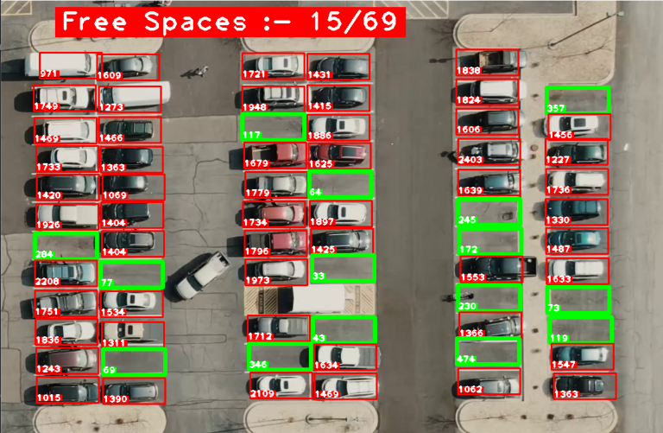
Fig 6: Output

Slide 19
Results obtained on varies parking slot images
Parking slot images | Total no. of slot available | No. of slot filled | No. of slot empty | No. of empty slot detected by model
1 | 69 | 54 | 15 | 15
2 | 50 | 30 | 20 | 20
3 | 34 | 20 | 14 | 14
4 | 40 | 15 | 25 | 25

Slide 20
CONCLUSION
“Car Parking Slot Detection Using YOLO Algorithm” will be done by fixing a camera at the parking slot which will be capturing the parking area images and using the YOLO algorithm, to detect and count the number of vehicles in each parking slot, by tracking the occupancy status of each slot over time, this provides real-time information to users about the availability of parking spaces. Having studied the different approaches and techniques in various survey papers as reference points, further work and study was conducted. After studying various Machine Learning algorithms, it was found that YOLO algorithm will produce more accurate result. Therefore, this algorithm will be used to develop the model to identify vacant and occupied parking slots and display number of vacant slots.

Slide 21
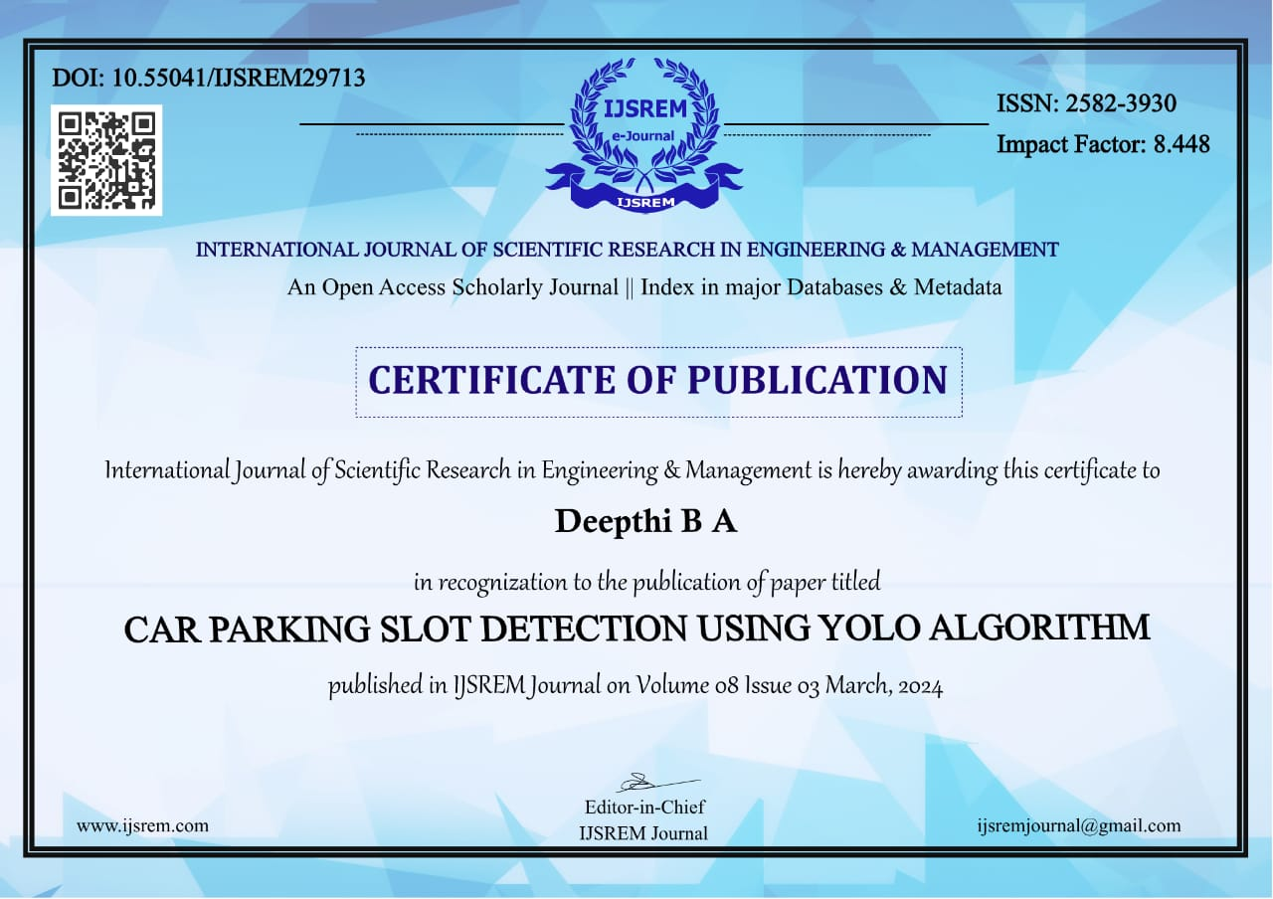

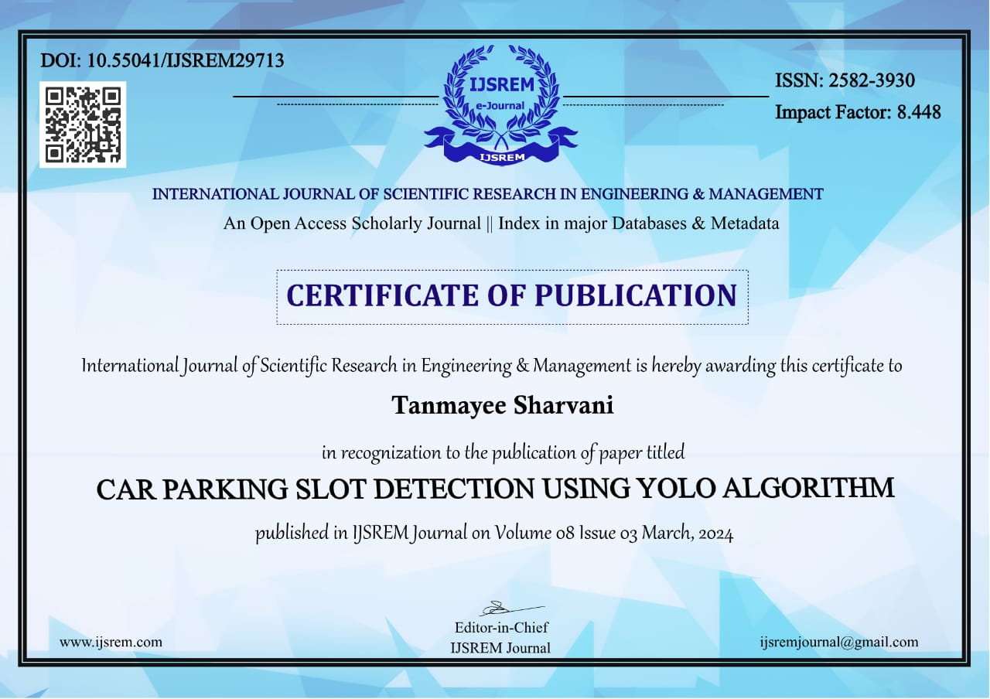


Slide 22
REFERENCES
[1] Bandi Sairam and Gopi Krishna "Automated Vehicle Parking Slot Detection System Using Deep Learning " Proceedings of the Fourth International Conference on Computing Methodologies and Communication (ICCMC 2020) IEEE Xplore Part Number:CFP20K25-ART; ISBN:978-1-7281-4889-2
[2] Raj Patel and Praveen Meduri "Car Detection Based Algorithm for Automatic Parking Space Detection" 2020 19th IEEE International Conference on Machine Learning and Applications (ICMLA)
[3] Moran JU and Haibo LUO "A Simple and Efficient Network for Small Target Detection" 2020 19th IEEE International Conference on Machine Learning and Applications (ICMLA)
[4] Hanbo Zhoua and Wei Xiangc "Method for judging parking status based on yolov2 target detection algorithm" The 8th International Conference on Information Technology and Quantitative Management (ITQM 2020 & 2021)

Slide 23
[5] Aakash K. Shetty and Yashkumar J. Patel “A Review: Object Detection Models" 2021 6th International Conference for Convergence in Technology (I2CT) Pune, India. Apr 02-04, 2021
[6] Cui Gao and Qiang Cai "YOLOv4 Object Detection Algorithm with Efficient Channel Attention Mechanism" 2020 5th International Conference on Mechanical, Control and Computer Engineering (ICMCCE)
[7] Se-Ho Park and Hyoseok Yoon "An All-in-One Vehicle Type and License Plate Recognition System Using YOLOv4" 2022 by the authors. Licensee MDPI
[8] Jingyi Zhao, Zhanlin JI (Member, IEEE) and Ivan Ganchev (Senior Member, IEEE) “Improved Vision-Based Vehicle Detection and Classification by Optimized YOLOv4” 2021 19th IEEE International Conference on Machine Learning and Applications (ICMLA)
[9] Guan Sheng Wong , Kah Ong Michael Goh and Aznul Qalid Md. Sabri “Review of Vision-Based Deep Learning Parking Slot Detection on Surround View Images” 2023 by the authors. Licensee MDPI
[10] Upendra Suddamalla and Balaji Ravichandiran “Camera Based Parking Slot Detection For Autonomous Parking” (2020).

Slide 24
[11] Fatma M. Talaat and Hanaa Zain Eldin “An improved fire detection approach based on YOLO-v8 for smart cities” Neural Computing and Applications (2023)
[12] Nabin Sharma and Rathachai Chawuthai “Parking Time Violation Tracking Using YOLOv8 and Tracking Algorithms” 2023 by the authors. Licensee MDPI
[13] Xiangwu Ding and Ruidi Yang “Vehicle and Parking Space Detection Based on Improved YOLO Network Model” ICAITA 2019
[14] Daniel Padilla Carrasco and Domènec Puig “T-YOLO: Tiny Vehicle Detection Based on YOLO and Multi-Scale Convolutional Neural Networks” 2021 19th IEEE International Conference on Machine Learning and Applications (ICMLA)
[15] Mamoona Humayun and Marwah Khalid Alsadun " Traffic Management: Multi-Scale Vehicle Detection in Varying Weather Conditions Using YOLOv4 and Spatial Pyramid Pooling Network " 2022 by the authors. Licensee MDPI

Slide 25
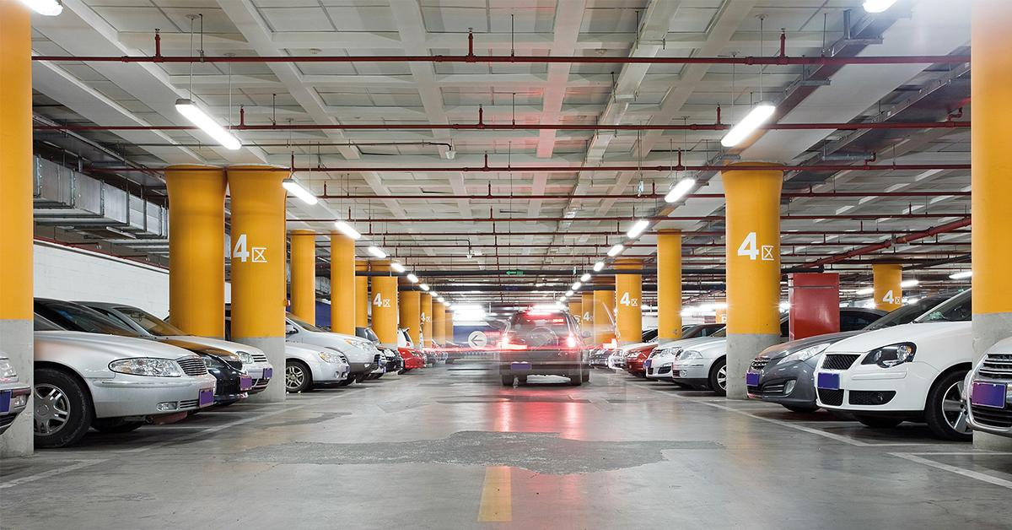
THANK YOU

